Slide 1
Music Recommendation System on Digital Music Dataset
Bowei Feng, Cong Deng

Slide 2
What is the problem
Data selection and preprocessing
Giving rating prediction
Recommending music
Model evaluation

Slide 3
Data selection and preprocessing
We choose a digital music data with over 64000 ratings, which is applied to 3568 movies by 5541 users.
Then we preprocess the data in two ways:
We simply split the dataset into two parts — 80% as training set and 20% as test set for each users.
We also choose some of users and some of their ratings to get train and test dataset.

Slide 4
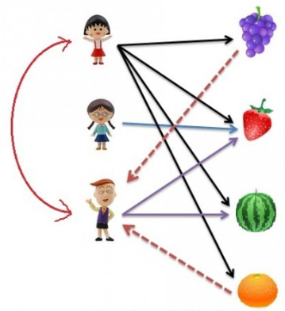
Giving rating prediction
Building the model:
Base on User-based Collaborative Filtering.
We apply Jaccard similarity to balance similarity and diversity between two users and Euclidean distance to calculate the similarity on the item they both rated.
Because of the sparsity of rating records, we should not only consider the items they both rated but also the proportion of items that have been jointly rated to total items that have been rated by them.

Slide 5
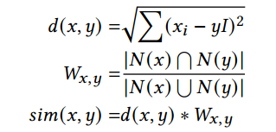
Giving rating prediction
Building the model:
Base on User-based Collaborative Filtering.
We apply Jaccard similarity to balance similarity and diversity between two users and Euclidean distance to calculate the similarity on the item they both rated.
The combined similarity between two users are:

Slide 6
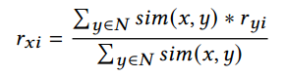
Recommending music
We have already given the similarity between two users. Next step is to give the recommendation. If we let N be the set of K users who are most similar to user x. So the rating that most likely user x will give to music i is:
After we calculate all the rating prediction, we can sort them and get a Top 10 recommendation list.

Slide 7
Model evaluation
The evaluation is running on the testing dataset.
And the result is shown as below:
MAE | RMSE | Precision | Recall | F-measure | NDCG
0.7763 | 1.1331 | 0.0512 | 0.0315 | 0.0386 | 0.2143

Slide 8
Conclusions and future work
There are some pros and cons of the model:
Pros:
Easy to implement
Context independent
Cons:
The percentage of people who rate items is really low.
New users will have no to little information about them to be compared with other users. And new items will lack of ratings to create a solid ranking.
Better recommendation requires more users as well as more computing power and time.

Slide 9
Conclusions and future work
As we calculate many criteria to assess whether the model is good or not, we think the most appropriate criterion is MAE and RMSE.
More computing power is needed if we want to conduct our model on a much bigger dataset. The benefit is apparent, we can get a more better recommandation.

